Slide 1


Wine Data Analysis:
BLUEBERRY WINERY
Presented by:
Jyotika Kalra
Davide Della Valle
04.12.2020

Slide 2

Agenda:
Data and scope
Previous analysis at a glance
Vinho Verde insights - Alvarinho grape
Douro insights
Aging of wine
Data Mining

Slide 3

Data and scope
Scope:
Data analysis to determine quality of wines produced based on ingredients and composition.
Price per bottle.
Data:
Wine Enthusiast (World‘s number 1 source for information, Magazine, website, 4.1M readers)
Country, Province, Variety, Points (conversion to quality standards), Price

Slide 4
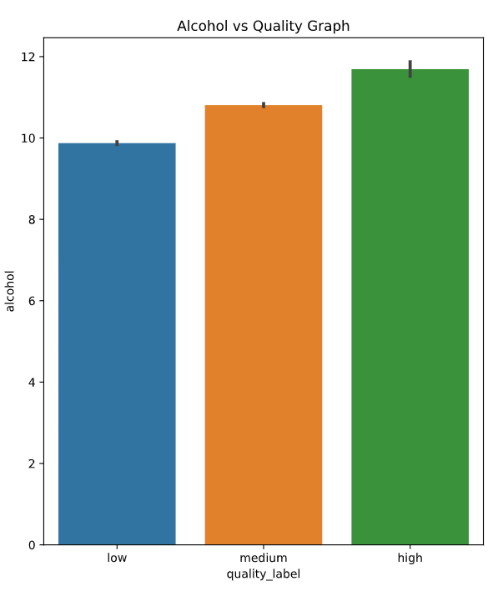
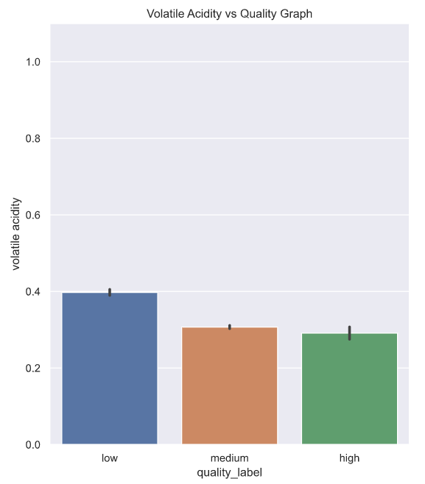
At a glance
Wine composition
Should be HIGH in Quantity
Should be LOW in Quantity

Slide 5
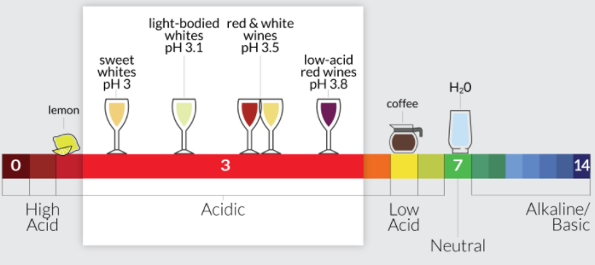
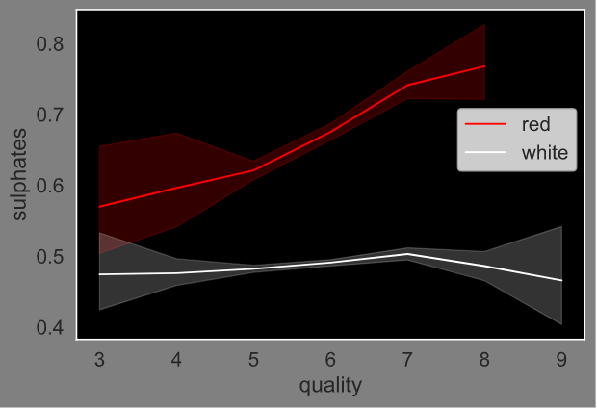
At a glance
Red and White
pH level between 3.2 to 3.6
Varies from Wine to Wine

Slide 6
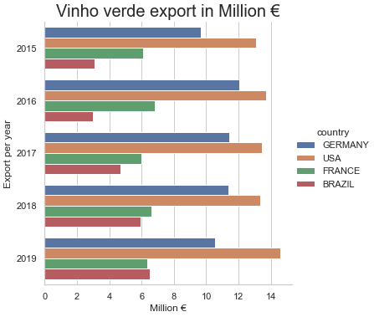
Export trends Vinho Verde
2010-2020:
Production: +23% to 66 M liters
Export liter: 32% 42% to 27M
Revenue in €: 38M +43% to 67M
Usa
2,69€
France
2,32€
Brazil
2,2€
Germany
1,95€

Slide 7
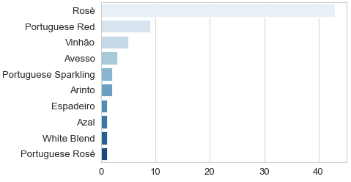
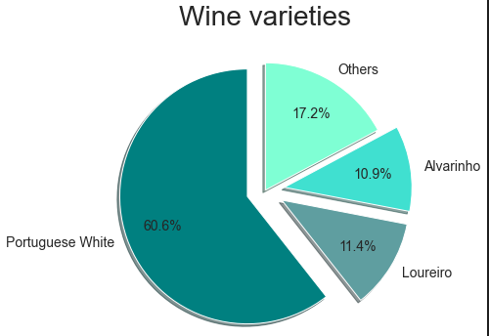
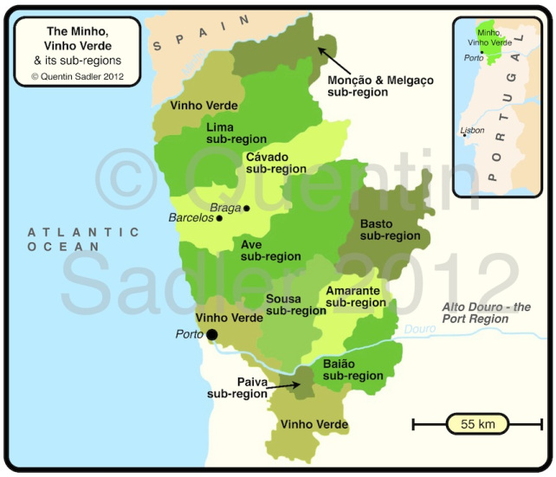
Grapes varieties Vinho Verde

Slide 8
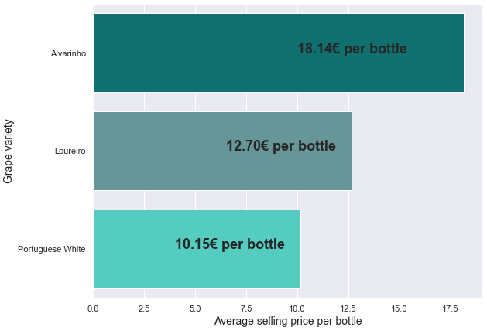
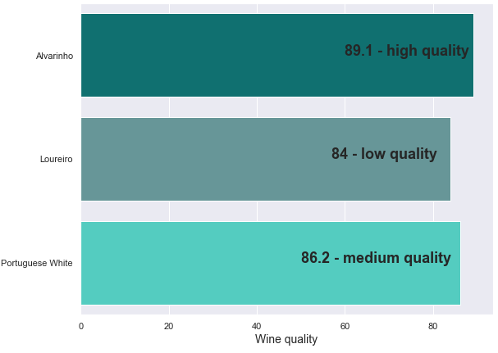
High quality wine for a fair price Alvarinho
Alvarinho
13€
21€
Loureiro
9€
15€
Portuguese White
8€
12€

Slide 9
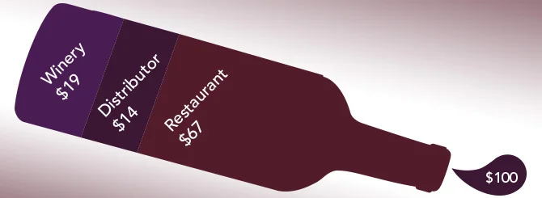
Breaking Down the Price
of a Bottle of Wine
3,45€
2,54€
18,14€
12,15€
Price per bottle
Winery
Distributor
Restaurant

Slide 10


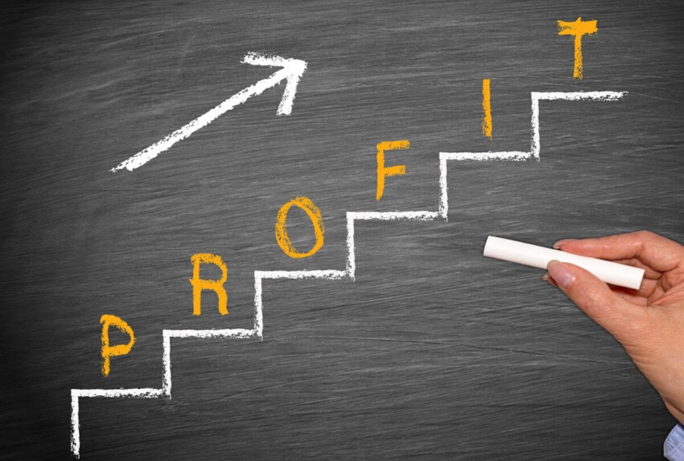
WHY DOURO Region ???

Slide 11
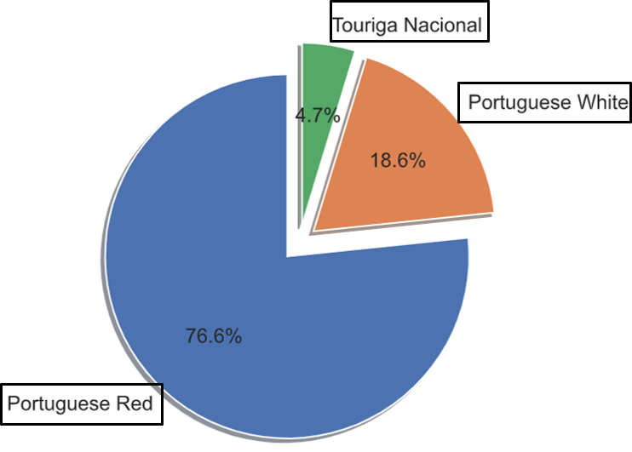
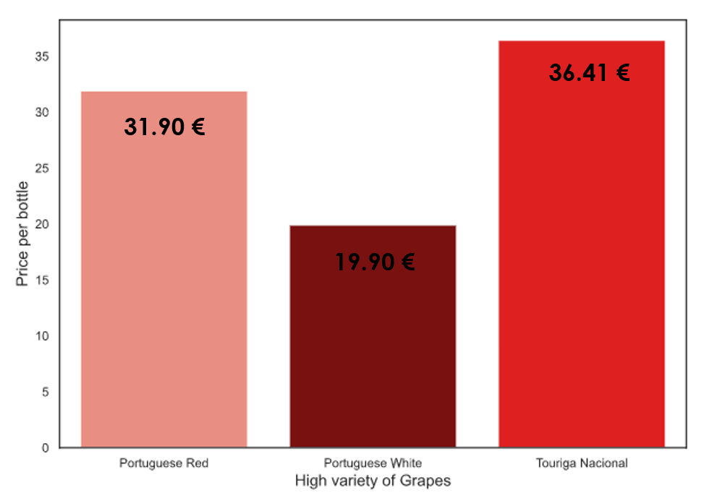
QUALITY ANALYSIS:
GRAPE QUALITY
PRICE AS PER GRAPE QUALITY

Slide 12

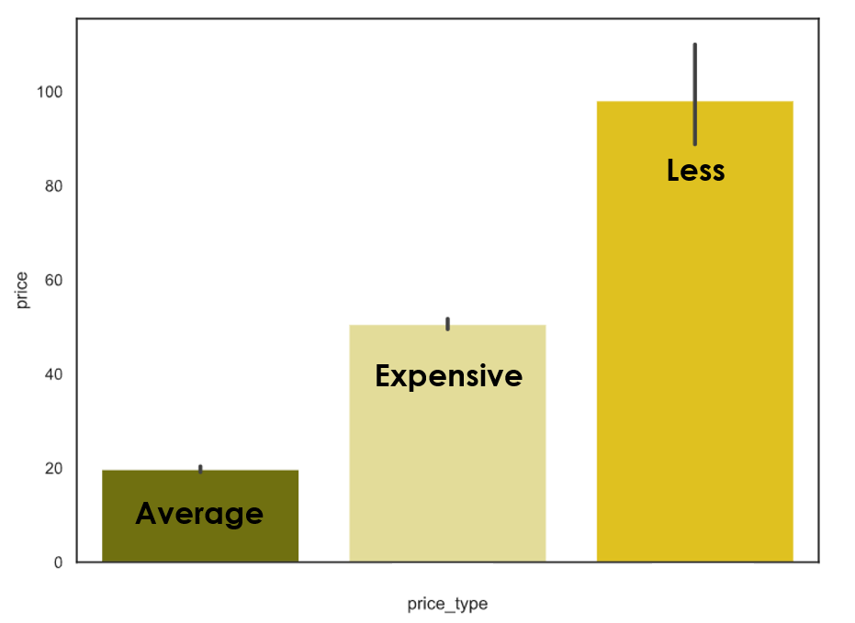


PRICE REGION:
Less than 40 € - LESS PRICE
Between 40 – 60 € - AVERAGE PRICE
More than 60 € - EXPENSIVE PRICE
Count
Price Type

Slide 13

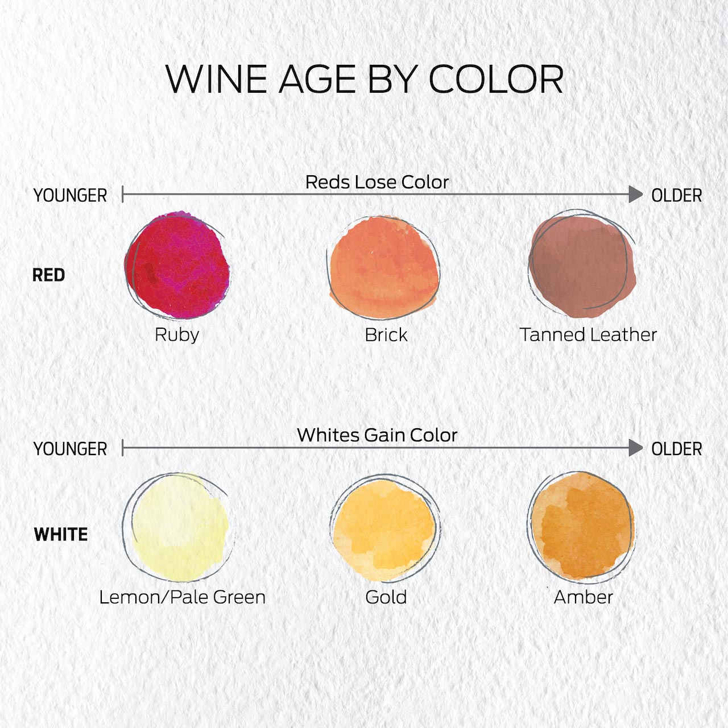
AGING/CELLARING OF WINE:
Bottles destined for aging need dark and cool storage around 53–57°F.
Reduces the acidity and tannin in a wine.
Provides fruit flavors taste mushy and baked.
Tasting historic wines that have withstood decades, and even centuries, is a transcendent experience.

Slide 14
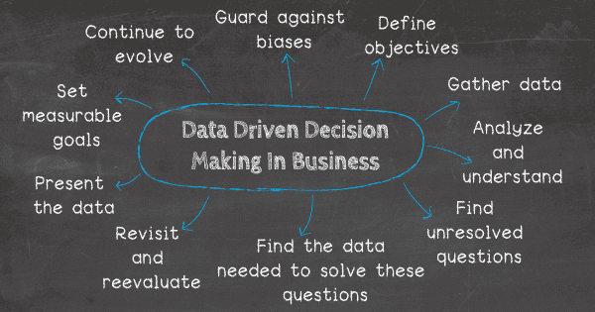
DATA MINING FOR FUTURE:
1. Understanding the needs of the business
2.
Finding unresolves questions
3.
Defining objectives
4.
Preparing the Data
5.
Goals for decision making

Slide 15
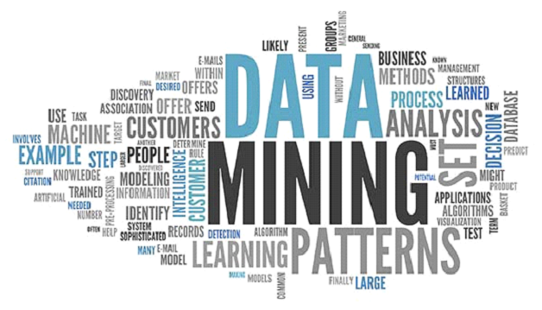
How does data mining help?
Increases revenue.
Understands customer segments and preferences.
Acquires new customers
Improves up-selling of products.
Retains customers and thus increases loyalty.
Detects frauds, if any.
Monitors operational performances.

